Slide 1
Keboola
Competitive Landscape

Slide 2
01
Introduction

Slide 3
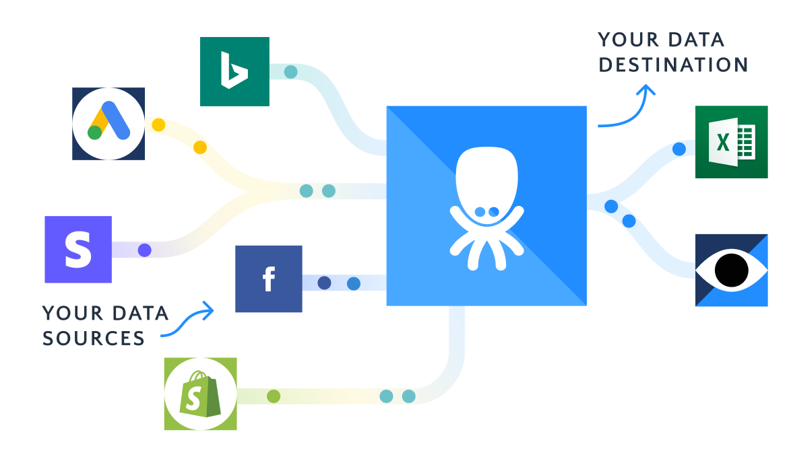
Fully-Managed Platform
Keboola is a self-service, all-in-one data operations platform
Integrates E(T)LT, Storage, Orchestration and analysis into one platform.
Typical pipeline definition and Orchestration
But also:
Observability
Metadata & Artifact Store Layer
Component Framework
Unified User Management
4.7/5

Slide 4
4 Types of Competition
All-in-one Stack
2. Indirect Competition
“Fully Managed” or “End-to-End”
Managed solution as a service
Data Integration Tools
Data Loaders
Orchestration Tools
Orchestrate bits of data tooling
Collect metadata
3. In-house Stack Built
on Cloud Primitives
4. Assembled Data Stack
Using major cloud providers
Often a combination of “cloud primitives” and services
Modern Data Stack
“Best of breed”
DWH as a center “glue”

Slide 5
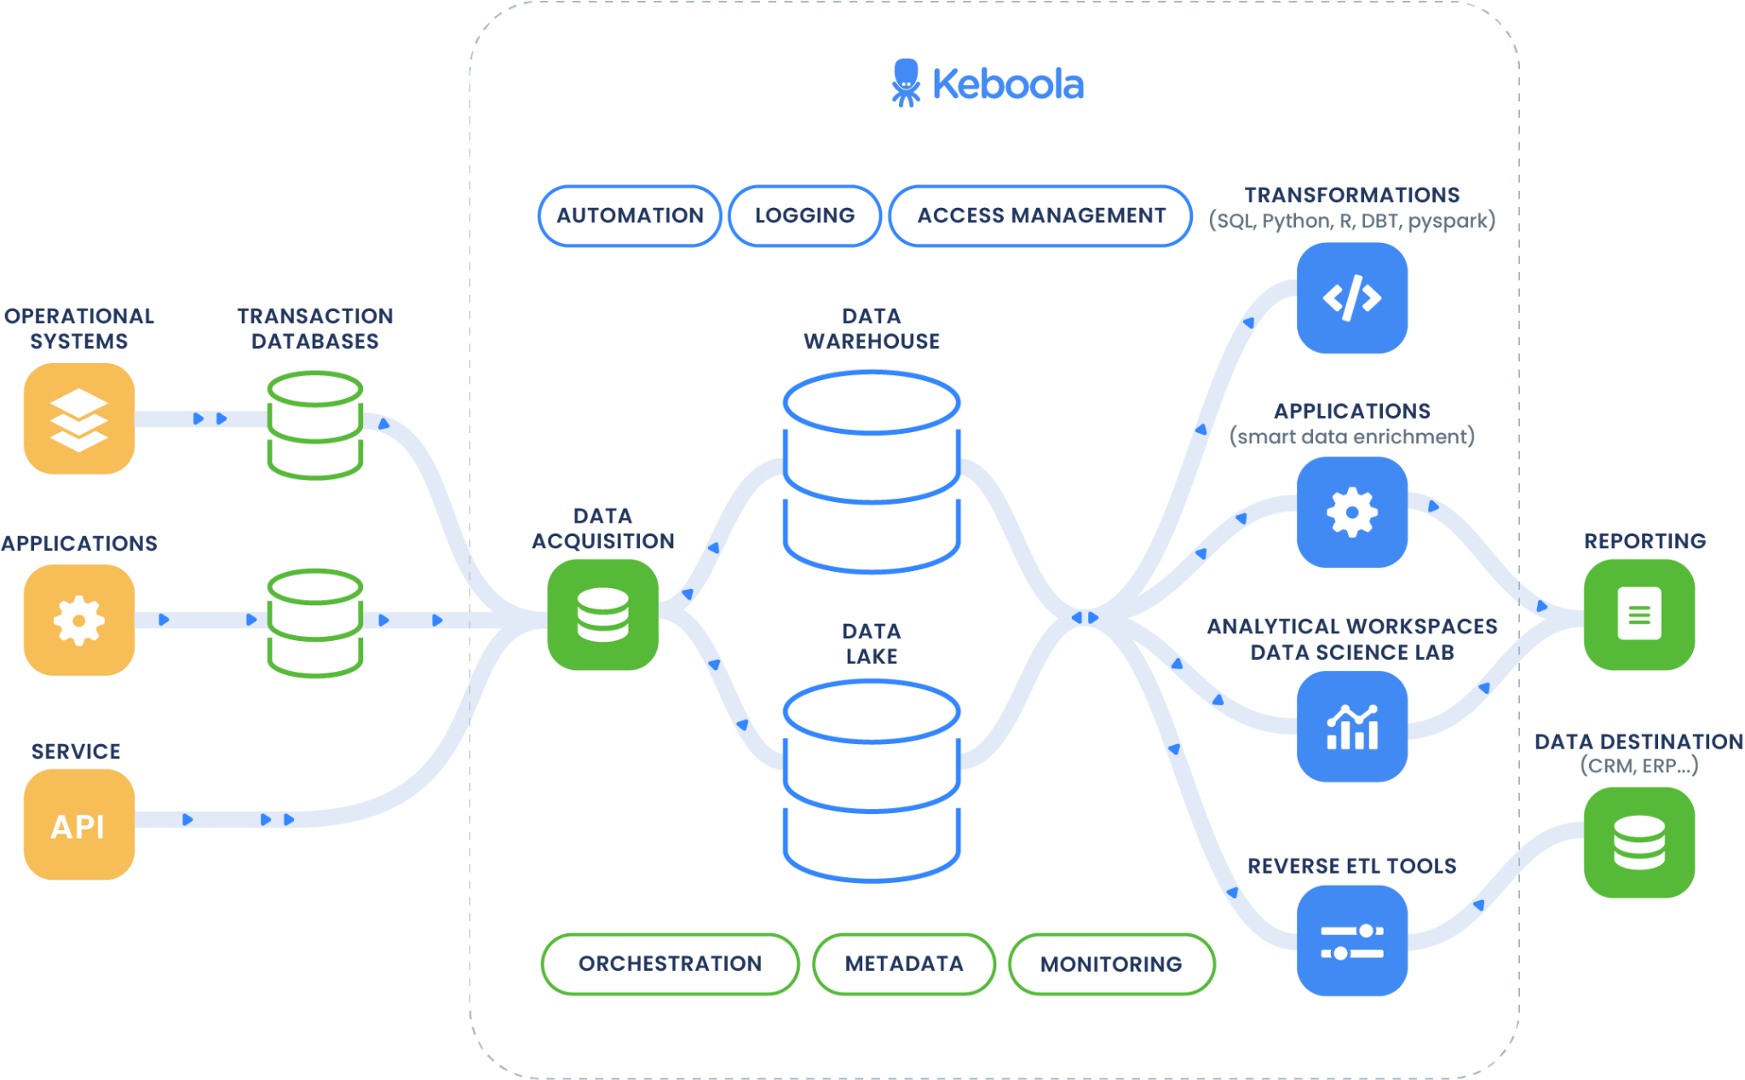
Data Stack
Data Stack
Notes:
Setting up data infrastructure takes time and involves key decisions regarding data modelling, infrastructure, governance, etc which can allow the organization to flourish when done right or severely limit an organization when done improperly.
The challenge is these architectural decisions are usually made at the beginning of an organization’s data journey or infancy of their data maturity so as the company’s requirements change and develop over time you need to have an architecture that is dependable to allow for operating business as usual while retaining its flexibility to adapt to the many more uses cases that the business demands.
At the end of the day, we have to remember that data practitioners/anyone working with data are the real heroes, and you are the people who can help your company to become more profitable, to save costs with automation, and come up with new revenue streams. This is important to remember that all these solutions, tools, architectures, are just there to empower you but you are the ones that actually do it.
This is why I really wanted to introduce our company’s history at the beginning because we encourage our users and customers to come to us and tells us about an interesting use cases or edge cases that needs to be resolved so we can do it together.

Slide 6
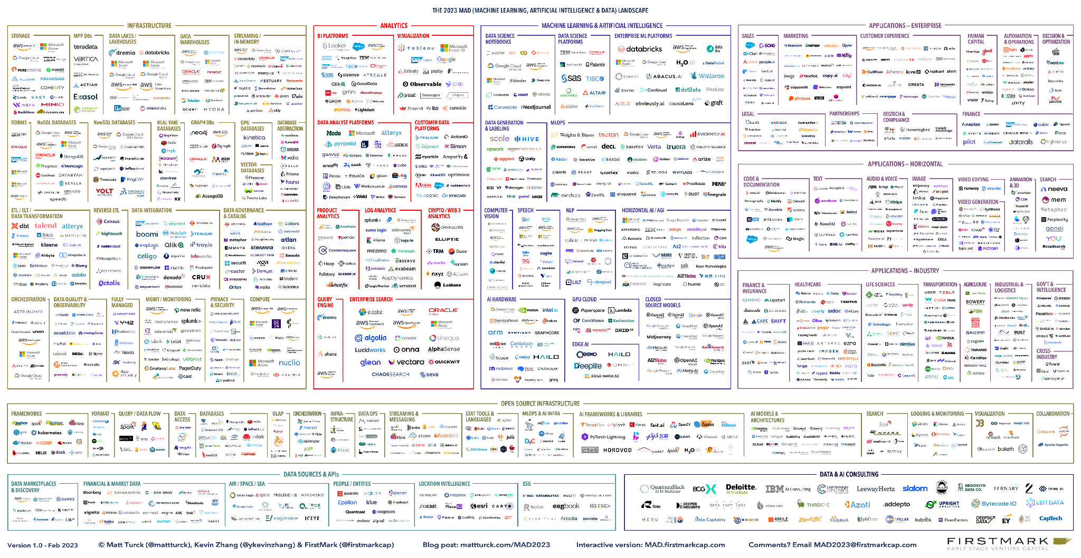
How to choose the right tool among so many?
Notes:
All of those services are at your disposal
How do you make the choice
How do you procure those services

Slide 7
How do we compare?
Solving scaling challenges for data teams due to organizational complexity
Data team size & Team maturity
Use cases execution & Data Maturity
Costs at different stages
But also:
Adaptability of the solution
Market conditions
Staffing & people
Regulatory environment (HIPAA, SOX, etc.)
TCO
Data Team & Maturity
Team
Tooling
Technical, mature team
Individual “miracle worker”
Non savvy users
Use cases
Single use case (often BI reporting)
Many use cases
Data Mesh-y
Notes:
When most software engineering teams think of scale they imagine a surprising number of API calls or millions of records written to a database in a concerning period of time. For 99% of data developers, we don’t have that problem. Scale for Data Teams is an issue of organizational complexity.

Slide 8
02
All-in-One Data Stack

Slide 9
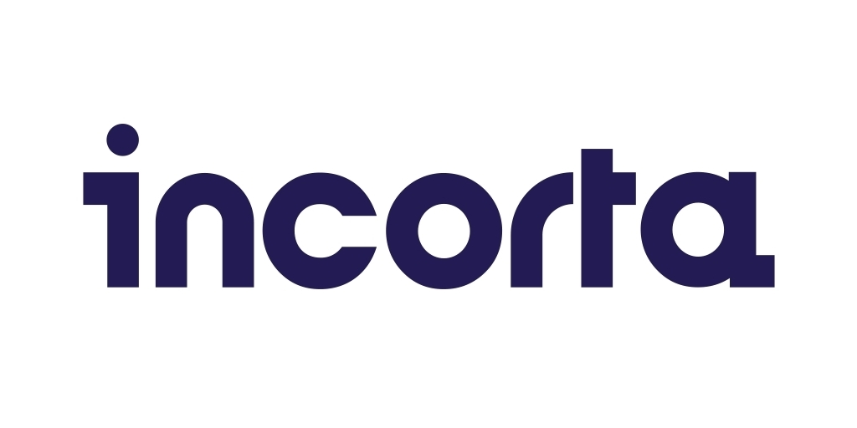
All-in-One Data Stack - Examples

Slide 10
All-in-One Data Stack - Specifics
“Instead of separately selecting, acquiring, configuring, and integrating an endless list of technologies to build your data stack, XXXXXXX gets you there in one platform. Stop working on your data infrastructure, and start using it instead.”
Unified solution with benefits of:
Governance & Metadata collection
One procurement item
Easier onboarding (1 vs. 5-7 tools)
Unified & dedicated support
Challenges:
Specific pricing logic
It’s Easier To Sell A Point Solution
Data Teams Want To Build Their Dream Data Infrastructure
Opinionated solution from technical perspective

Slide 11
All-in-One Data Stack - Summary
Aspect | Level | All-in-One Stack
Data Team | Non-savvy users | Easy to start
 | Individual “miracle worker” | Platform augments user(s)
 | Technical, mature team | Specific internal framework & “development for resume”
 | Mix of data team and business users | Right fit
Use Cases | Single use case (often BI reporting) | straightforward
 | Many use cases | facilitates
 | Data Mesh | Facilitates
Costs (TCO) | Tooling | Only in comparison to manual solutions
 | Human Capital | Platform augments teams

Slide 12
Not All E2E Platforms are Equal
Packaged SaaS solutions
Platform that consist of the combination of homegrown solution as a glue for SaaS services and open source tools
External costs, often only partial governance & integration
Packaged open source tools
Platform that consist of the combination of homegrown solution as a glue for open source tools (pre-packaged modern data stack)
Still high requirement for technical staff, maintains complexity and barrier to entry
Homegrown solution
Platform developed from the scratch & fully integrated and adopting other technologies own way
Opinionated solution but with great UX
Also see: The Next Generation Of All-In-One Data Stacks | by Ben Rogojan | SeattleDataGuy By SeattleDataGuy | Medium

Slide 13
03
“Assembled”
(Modern) Data Stack

Slide 14
Modern Data Stack
Otherwise known as the combination of “best-in-breed” solutions and has risen to popularity since the early 2010s. The main disadvantage of this approach is the need to stitch together several enterprise-grade solutions and the inherent challenges/disadvantages that it comes with:
Commercial Disadvantages
Cost effectiveness
In terms of the bottom-line, implementing and maintaining a MDS can be much more expensive than alternative approaches since you need to pay several different vendors which each have their own contracts and pricing model.
Furthermore, you may need to hire additional staff with specialized skills just to build, operate, and maintain it.
Time to value
The MDS comes with significant complexity and requires specialized skills to build, operate, and maintain it. As a result, there may be a steep learning curve for new employees or a need to hire additional staff with specialized skills before this approach starts to provide value.
The current data landscape is filled with solutions, perhaps too many solutions, which means that it is usually a significant time investment to select the appropriate solutions/vendors for your custom MDS.

Slide 15
Modern Data Stack
Technical Disadvantages
Training
When you stitch together tools, it creates gaps in integration between them and requires additional training with the various interfaces.
Maintenance
The MDS requires regular maintenance to ensure that it is functioning seamlessly. This is usually a time-consuming task and may require dedicated resources to manage which means that there is little to no time to accomplish the revenue-generating, long-tail use cases.
Governance
To maintain complete control over all the tools that are assembled together, an additional tool is required, which increases complexity and requires additional knowledge and personal resources. Additionally, it can be difficult to maintain complete control over all the tools, which can lead to security risks and data breaches. Furthermore, it can be challenging to ensure interoperability between different tools, which can lead to data silos and incompatibility issues. Also it is important to ensure that all the tools are up-to-date and compatible with each other, which can lead to performance issues and downtime.
Scalability
The process of scaling and adding additional resources and tools to address performance or requirements issues can lead to challenges associated with a high increase in complexity, which may result in increased costs and reduced efficiency.

Slide 16
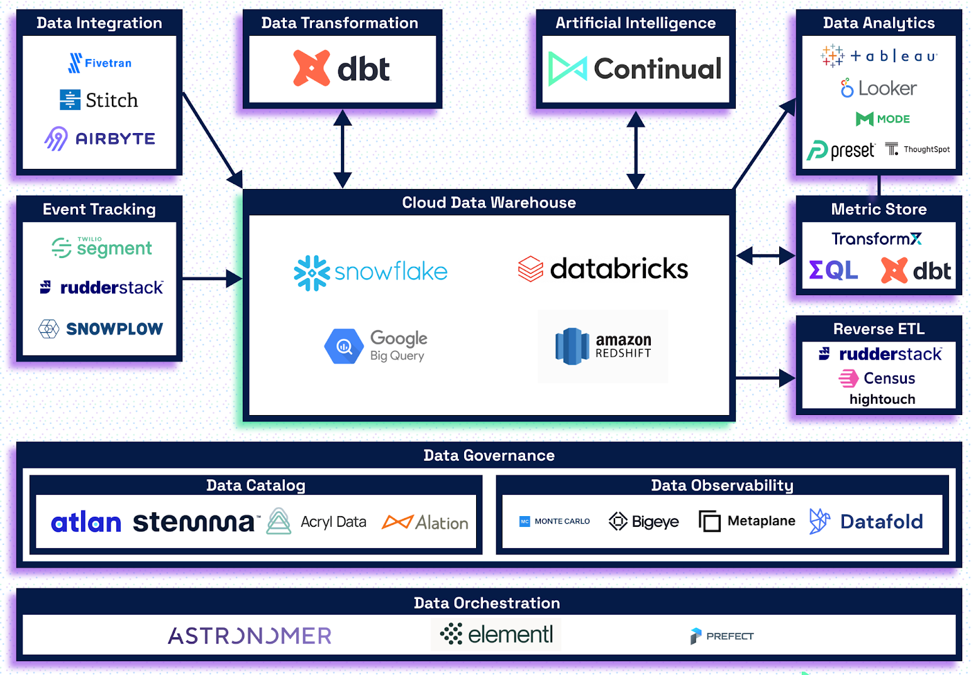
Modern Data Stack

Slide 17
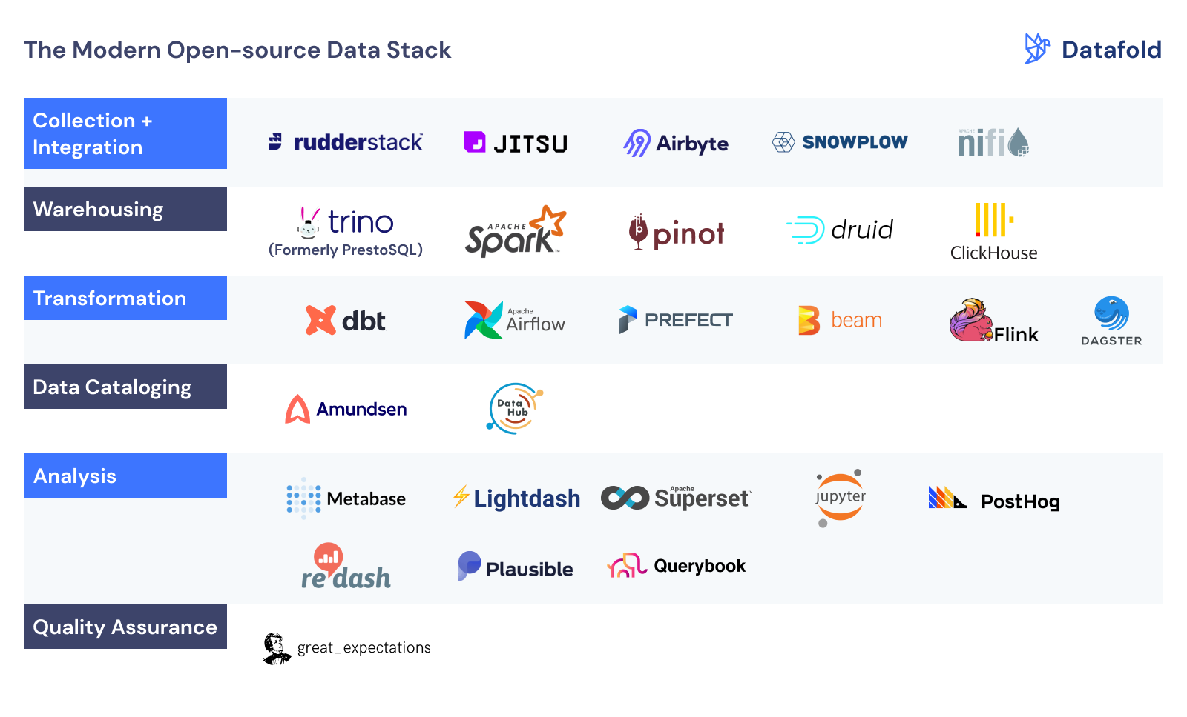
Issues with Modern Data Stack (MDS)
MDS often poses a dilemma: Which tool should be added, and why? When is it enough?
Every new tool in your stack brings additional costs:
Licensing fees
Employee onboarding, training, and hiring
the right expertise.
Other challenges with MDS include:
Data teams dedicating more time to infrastructure maintenance than to data and applications.
Tool friction, leading to data silos.
Increased effort to address the consequences of data silos.
Notes:
In any typical data architecture today, data practitioners are faced with a constant need to decide and report which tool to plug in and why that tool makes more sense than a pool of other options. Every time a new tool is onboarded, an excess cost is incurred behind the solution and licensing fees which have to be processed and renewed recurrently. There’s also a huge cost behind employee onboarding, training, and hiring the right expertise. Especially when it comes to niche tools that require specific skills.
The MDS redirects data teams from focussing on data and applications to maintaining the infrastructure that powers the data and applications.
there is rampant friction between tools, leading to data and insights being caged within the walls of siloed tools and environments.
No common layer for business teams to define, enforce, and operate business logic and requirements across the physical data and architectures exists. This actively increases the number of interactions between teams to resolve the after-effects of data solos.

Slide 18
Invisible components of Modern Data stack
Logging
Access Management
Data residency
Cost attribution

Slide 19
Modern Data Stack - Summary
Aspect | Level | Modern Data Stack
Data Team | Non-savvy users | N/A
 | Individual “miracle worker” | Typical pick (US)
 | Technical, mature team | Starting to feel limitations/ own tooling on the top
 | Mix of data team and business users | Maintains dependency on data team
Use Cases | Single use case (often BI reporting) | Easy to start with the right team
 | Many use cases | Scalability issues (Expansion of toolset)
 | Data Mesh | Maintains dependency on data team
Costs (TCO) | Tooling | Total cost of tooling usually very high
 | Human Capital | Human capital intensive

Slide 20
04
In-house data stack on Azure/ GCP/ AWS

Slide 21
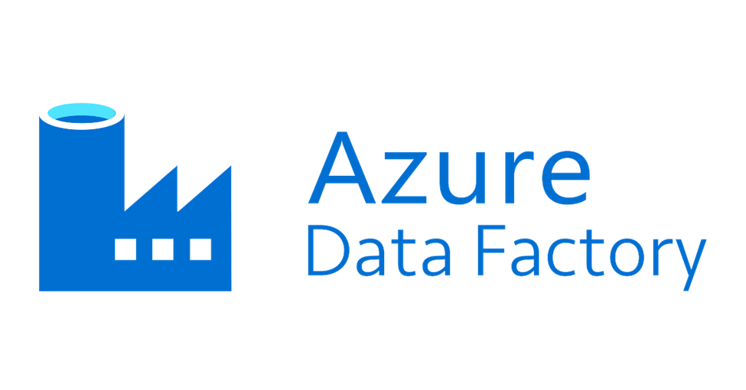
In-house data stack - Examples

Slide 22
Cloud Providers
“Code first teams require a special ecosystem to thrive. Such as right skills, team culture, organization and considerable resources. The great advantage of code first is that you not only get to enjoy low hanging fruits but also the high hanging ones. This works out well for forward thinking organizations that have the will, patience and resources for such an ecosystem.”
Martand Singhal

Slide 23
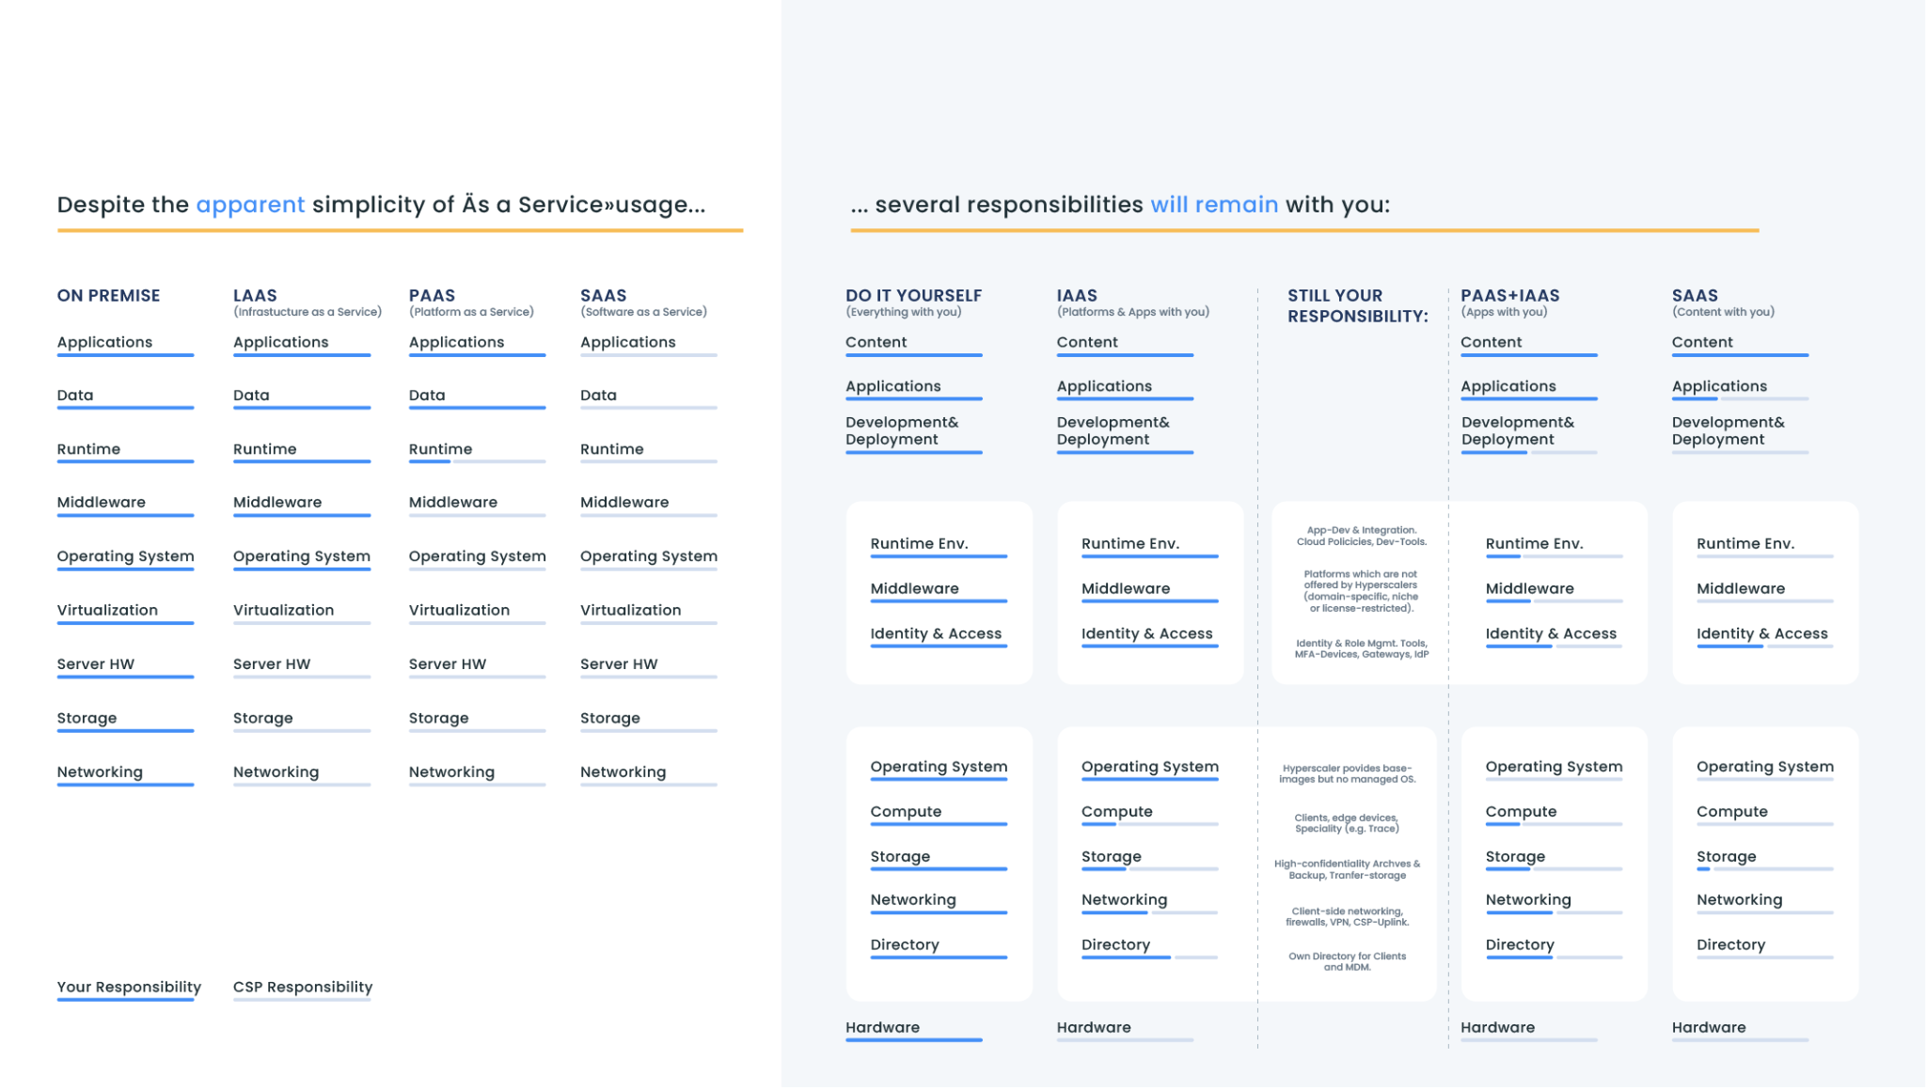
Cloud management platform
Governed and automated access to all infrastructure layers

Slide 24
Cloud Providers - Summary
Aspect | Level | In-house Data Stack
Data Team | Non-savvy users | N/A
 | Individual “miracle worker” | Scalability issues, lot of time wasted on setup & maintenance
 | Technical, mature team | Preferred pick
 | Mix of data team and business users | maintains dependency on data team
Use Cases | Single use case (often BI reporting) | Usually simple if the right team is in
 | Many use cases | Scalability issues (Team perspective)
 | Data Mesh | Long-term development, unsure ROI
Costs (TCO) | Tooling | Can reach low tooling costs
 | Human Capital | Human capital intensive

Slide 25
05
Indirect competition

Slide 26
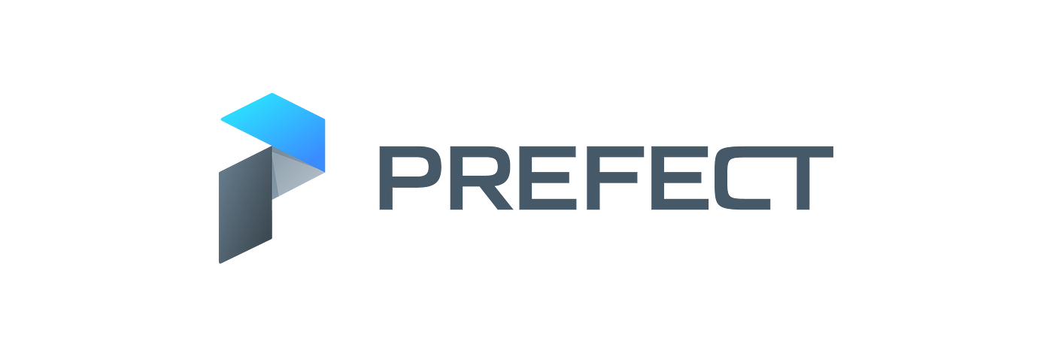
Indirect competition - Examples

Slide 27
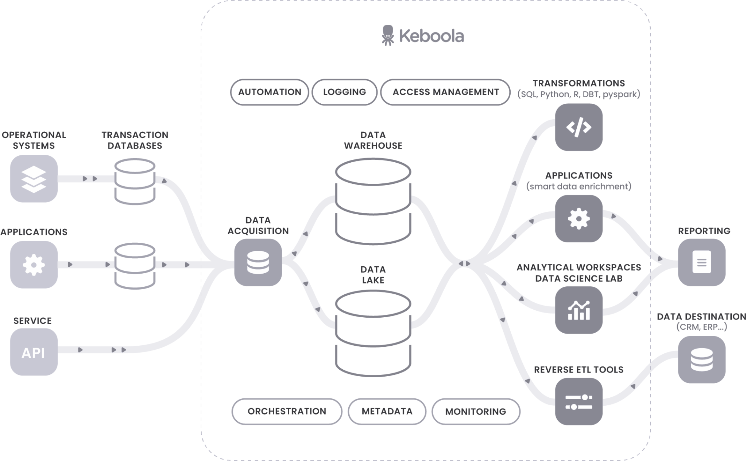
Indirect Competitors
Tools rather than platforms
Usually serving a single purpose
Two most common groups:
Data integration tools
Orchestrators

Slide 28
Data Loaders
Reliability & Performance
check review sites, slack groups
Costs / Pricing
Credit-based
Rows / MARs
Number of connectors
Out of the box connector list - beware of longtail
Maintenance & Support
Every solution will have times when it breaks
Alerting & support
Expandability
Can we develop connectors self-serve?
How much does it cost to contract anyone?
Does company listens to the requests?
Compliance

Slide 29
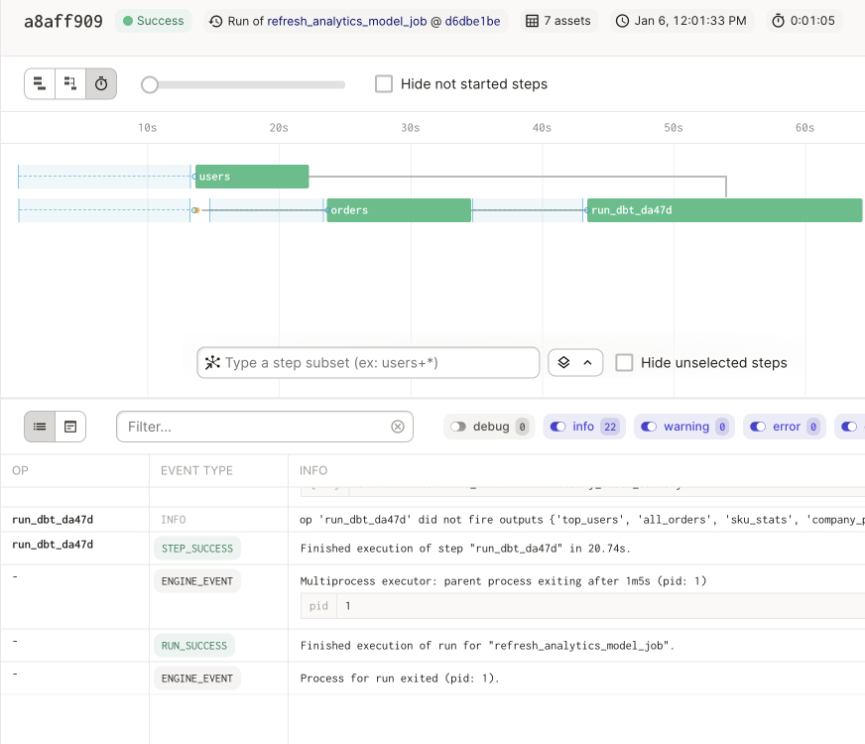
Orchestration Tools
Two main duties:
Controls pipelines
Store technical Metadata & Artifacts
Integration challenge by its own
Out of the box integrations
Complexity of the job definition
Code
UI
Observability & notification
Maintenance
Onboarding and learning curve

Slide 30
06
Conclusion

Slide 31
There are 3 main competitor groups for Keboola and few indirect competitor groups
The decision for client should be based on several factors, such as:
Data team size & Team maturity
Use cases execution & Data Maturity
Costs at different stages
Regulations, market conditions, people
Often clients come to us from one angle and we discover their data strategy is not complete
It is important to identify the use cases and main pain points
Conclusion

Slide 32
Conclusion - Focus on value
Aspect | Level | Fully Managed Stack | Modern Data Stack | Cloud Assembly Stack
Data Team | Non-savvy users | Easy to start | N/A | N/A
 | Individual “miracle worker” | Platform augments user(s) | Typical pick (US) | Scalability issues, lot of time wasted on setup & maintenance
 | Technical, mature team | Specific internal framework & “development for resume” | Starting to feel limitations/own tooling on the top | Preferred pick
 | Mix of data team and business users | Right fit | maintains dependency on data team | maintains dependency on data team
Use Cases | Single use case (often BI reporting) | straightforward | Easy to start with the right team | Usually simple if the right team is in
 | Many use cases | facilitates | Scalability issues (Expansion of toolset) | Scalability issues (Team perspective)
 | Data Mesh | Facilitates | Maintains dependency on data team | Long-term development, unsure ROI
Costs (TCO) | Tooling | Only in comparison to manual solutions | Total cost of tooling usually very high | Can reach low tooling costs
 | Human Capital | Platform augments teams | Human capital intensive | Human capital intensive

Slide 33
Reading
The Future of Data - by Pedram Navid
The Next Generation Of All-In-One Data Stacks - by Ben Rogojan
How Scale Kills Data Teams - by Chad Sanderson
Optimizing Data Modeling for the Data-First Stack
The Essence of Having Your Own Data Developer Platform
Re-Engineering the Data Value Chain
The Data Engineer is dead, long live the (Data) Platform Engineer - by Robert Sahlin
DBT Core & Airflow. Empowering our data organization with… - by Albert Franzi
Build vs Buy - by Neelesh Salian

